Slide 1
Computer Vision
Part 3: Two-Stage Object Detection
ADF – Start 08:30

Slide 2

Agenda
Part 1: Object Localization
Part 2: Classical Object Detection
Part 3: Two-Stage Object Detection
Part 4: One-Stage Object Detection
Computer Vision

Slide 3
Region-based Convolutional Neural Network
Computer Vision

Slide 4

R-CNN
Bbox
Class
Classify regions with SVMs or simple linear classifier
Bbox
Class
ConvNet
Bbox
Class
ConvNet
Forward each region through ConvNet
Linear Regression for bounding box offsets (correction)
ConvNet
Warped (crop and resize) image regions (224x224)
Regions of Interest (RoI) from a region proposal method (~2k)
Input Image
[Girschick et al, “Rich feature hierarchies for accurate object detection and semantic segmentation”, CVPR 2014]
Computer Vision

Slide 5
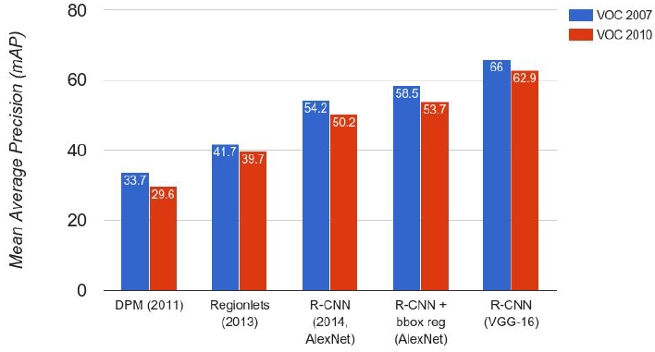
R-CNN Results
Big improvement compared to pre-CNN methods
Bounding box regression helps a bit
Features from a deeper network help a lot
[Wang et al, “Regionlets for Generic Object Detection”, ICCV 2013]
Computer Vision

Slide 6
R-CNN Problems
Training pipeline is post-hoc
Bbox
Class
ConvNet
Pretrained CNN
trainable
untrainable
Computer Vision

Slide 7
R-CNN Problems
ConvNet
Pretrained CNN
Training pipeline is post-hoc
pool5 features
ConvNet
ConvNet
Bbox
Class
Train SVMs and regressions per class
SLOW training (84h)
Save to disk
~200GB just for
PASCAL dataset
Data train
Computer Vision

Slide 8
R-CNN Problems
Bbox
Class
Slow at test-time
Need to run full forward pass of CNN for each regional proposal (~2k forward passes for each image)
47s/image with VGG16 [Simonyan & Zisserman. ICLR15]
Now it’s somewhat called “Slow” R-CNN
Bbox
Class
ConvNet
Bbox
Class
ConvNet
ConvNet
Computer Vision

Slide 9
Idea to Solve
Bbox
Class
Slow at test-time due to independent forward passes
Solution: Swap convolution and warping
Process image before cropping
Share computation
Bbox
Class
ConvNet
Bbox
Class
ConvNet
ConvNet
Computer Vision

Slide 10
Fast R-CNN
Computer Vision

Slide 11
Fast R-CNN
First, do not perform region proposal on input image
Instead, Project region proposal to smaller feature map
Image Feature map (e.g. conv5 feature)
ConvNet
Forward whole image through ConvNet
“Backbone” network:
AlexNet, VGG, ResNet, etc
Input Image
Input Image
Computer Vision

Slide 12
Fast R-CNN
Perform Region Proposal to the feature map
Regions of Interest (RoIs) from a proposal method
Image Feature map (e.g. conv5 feature)
ConvNet
Forward whole image through ConvNet
“Backbone” network:
AlexNet, VGG, ResNet, etc
Input Image
Computer Vision

Slide 13
Fast R-CNN
Crop + Resize features
RoI Pooling
Regions of Interest (RoIs) from a proposal method
Image Feature map (e.g. conv5 feature)
ConvNet
Forward whole image through ConvNet
“Backbone” network:
AlexNet, VGG, ResNet, etc
Input Image
Computer Vision

Slide 14
Fast R-CNN
Feed feature patches into Per-Region Network
CNN
CNN
CNN
Per-Region Network
RoI Pooling
Regions of Interest (RoIs) from a proposal method
Image Feature map (e.g. conv5 feature)
ConvNet
Forward whole image through ConvNet
“Backbone” network:
AlexNet, VGG, ResNet, etc
Input Image
Computer Vision

Slide 15
Fast R-CNN
Bbox
Bbox
Bbox
Class
Class
Class
Linear+softmax
Output classification and box regression head
CNN
CNN
CNN
Per-Region Network
RoI Pooling
Regions of Interest (RoIs) from a proposal method
Image Feature map (e.g. conv5 feature)
ConvNet
Forward whole image through ConvNet
“Backbone” network:
AlexNet, VGG, ResNet, etc
Input Image
Computer Vision

Slide 16
Fast R-CNN
Bbox
Bbox
Bbox
Class
Class
Class
Per-Region network is relatively lightweight
CNN
CNN
CNN
Most of the computation happens in backbone network;
this saves work for overlapping region proposals
ConvNet
Computer Vision

Slide 17
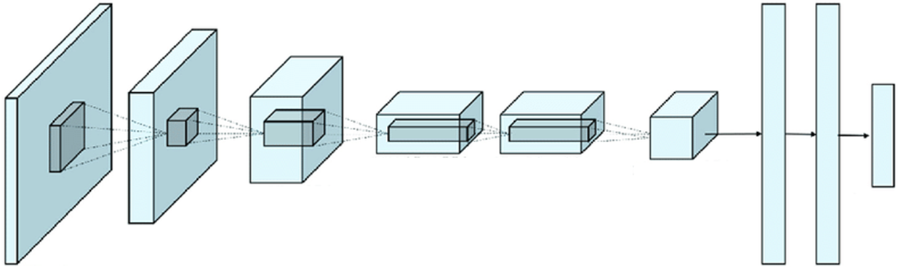

Fast R-CNN Backbones
Bbox
Bbox
Bbox
Class
Class
Class
Example:
When using AlexNet for detection,
five conv layers are used for backbone and
two FC layers are used for per-region network
CNN
CNN
CNN
ConvNet
Computer Vision

Slide 18
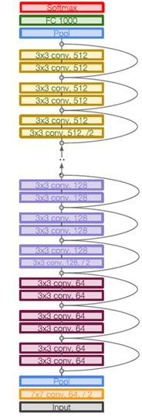
Fast R-CNN Backbones
Bbox
Bbox
Bbox
Class
Class
Class
Example:
For ResNet,
last stage is used as per-region network;
the rest of the network is used as backbone
CNN
CNN
CNN
ConvNet
Computer Vision

Slide 19
Fast R-CNN
Bbox
Bbox
Bbox
Class
Class
Class
CNN
CNN
CNN
RoI Pooling
How to crop features?
ConvNet
Computer Vision

Slide 20
Region of Interest Pooling
Computer Vision

Slide 21
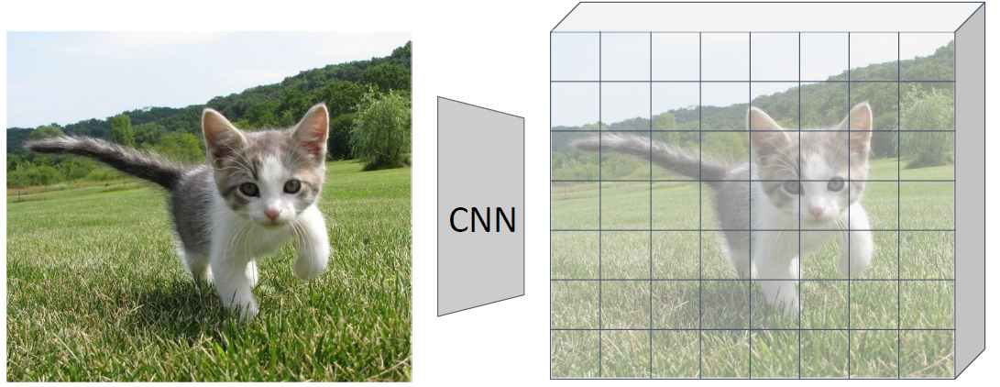
Fast R-CNN: Region of Interest Pooling
Project region proposal onto conv feature map
FC layer
Problem:
Fully-connected layers expect low-res conv features
C x h x w
Computer Vision

Slide 22
Fast R-CNN: Region of Interest Pooling
Project region proposal onto conv feature map
FC layer
Problem:
Fully-connected layers expect low-res conv features
C x h x w
“Snap” to grid cells
Computer Vision

Slide 23
Fast R-CNN: Region of Interest Pooling
Project region proposal onto conv feature map
Divide into 2x2
grid of (roughly)
equal subregions
FC layer
Problem:
Fully-connected layers expect low-res conv features
C x h x w
“Snap” to grid cells
Computer Vision

Slide 24
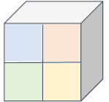
Fast R-CNN: Region of Interest Pooling
Project region proposal onto conv feature map
Divide into 2x2
grid of (roughly)
equal subregions
Max-pool within
each subregion
FC layer
Solved: Region features always the same size even if input regions have different sizes!
“Snap” to grid cells
Computer Vision

Slide 25
Fast R-CNN Train
Bbox
Bbox
Bbox
Log loss + Smooth L1 Loss
Class
Class
Class
Combine classification and regression loss
Multitask Loss
CNN
CNN
CNN
ConvNet
Computer Vision

Slide 26
Fast R-CNN Train
Bbox
Bbox
Bbox
Log loss + Smooth L1 Loss
Class
Class
Class
Train as a single pipeline
Backprop RoI Pool similar to max pooling
Multitask Loss
CNN
CNN
CNN
ConvNet
Computer Vision

Slide 27
Fast R-CNN Results [2014]
 | R-CNN | Fast R-CNN
Training Time | 84 hours | 8.75 hours
Speedup | 1x | 8.8x
Fast!
Test time per image | 47 seconds | 0.32 seconds
Speedup | 1x | 146x
Faster!
Better!
mAP (VOC 2007) | 66.0 | 66.9
Using VGG-16 CNN on Pascal VOC 2007 dataset
Computer Vision

Slide 28
Fast R-CNN Results
Test-time
 | R-CNN | Fast R-CNN
Test time per image | 47 seconds | 0.32 seconds
Speedup | 1x | 146x
Test time per image with Selective Search | 49 seconds | 2.3 seconds
Speedup | 1x | 25x
Computer Vision

Slide 29
Fast R-CNN Problems
Region Proposal is not using Convolution
Runtime dominated by region proposals
Test time:
With region proposals : 2.3 sec
Without region proposals : 0.32 sec
Bottleneck at Region Proposal!
Computer Vision

Slide 30
Faster R-CNN Learnable Region Proposals
Computer Vision

Slide 31
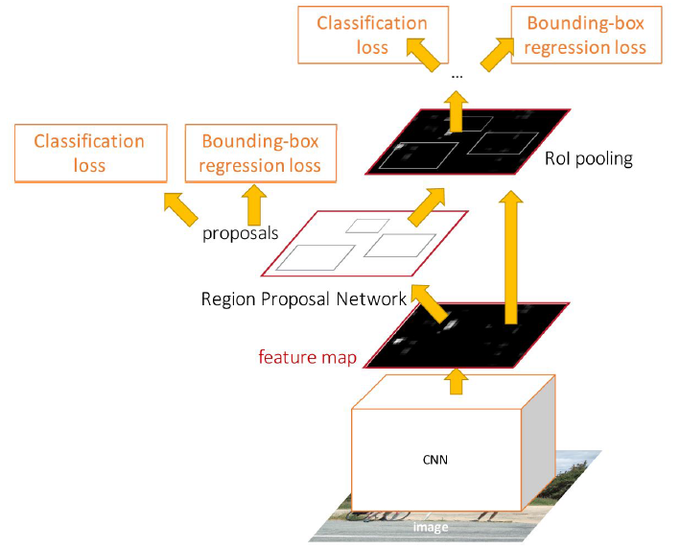
Faster R-CNN
Insert a Region Proposal Network (RPN) after the last conv layer
RPN trained to produce region proposals directly
no need for external region proposals!
[Ren et al, “Faster R-CNN: Towards Real-Time Object Detection with Region Proposal Networks”, NIPS 2015]
Computer Vision

Slide 32
Region Proposal Network
Computer Vision

Slide 33
Region Proposal Network
Run backbone CNN to get features aligned to input image
Computer Vision

Slide 34
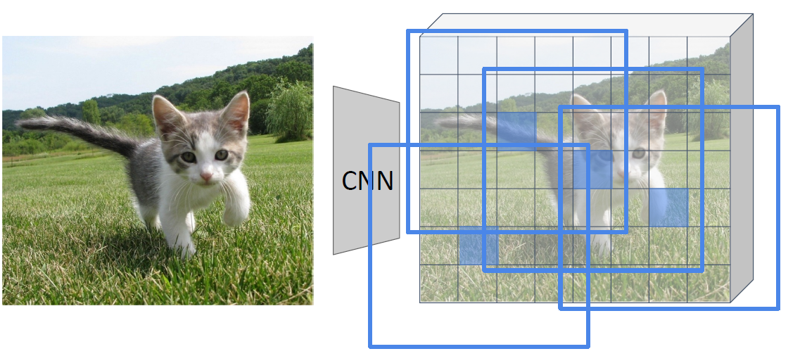
Region Proposal Network
Imagine an anchor box of fixed size at each point in the feature map
Computer Vision

Slide 35
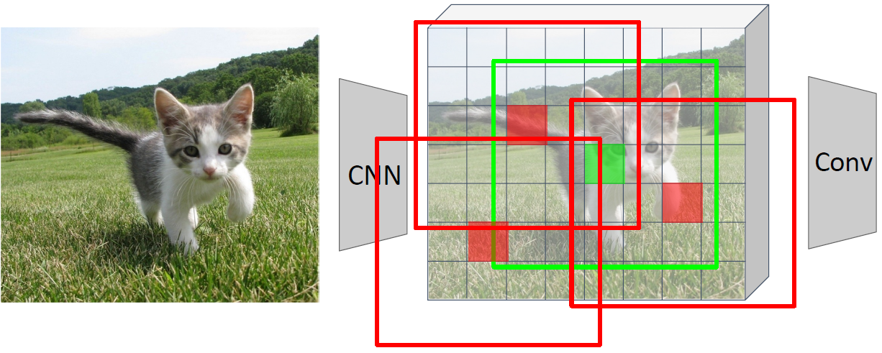
Region Proposal Network
At each point, predict whether the corresponding anchor contains an object
(per-cell logistic regression, predict scores with conv layer)
Anchor is an object?
1 x 20 x 15
Computer Vision

Slide 36
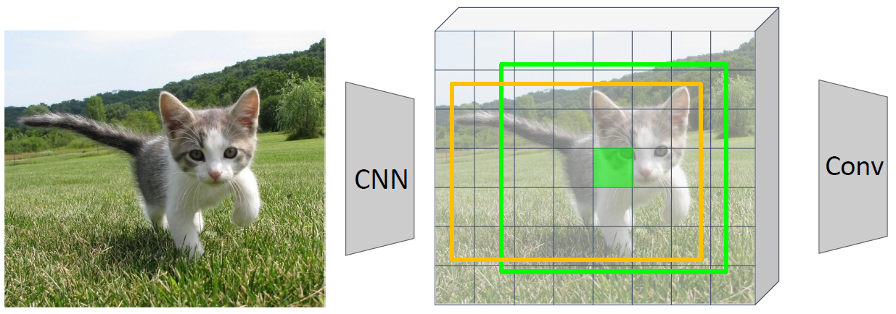
Region Proposal Network
For positive boxes, also predict a box transform to regress from anchor box to object box
Anchor is an object?
1 x 20 x 15
Box Transforms
4 x 20 x 15
Computer Vision

Slide 37
Region Proposal Network
Problem: Anchor box may have the wrong size / shape
Anchor is an object?
1 x 20 x 15
Box Transforms
4 x 20 x 15
Computer Vision

Slide 38
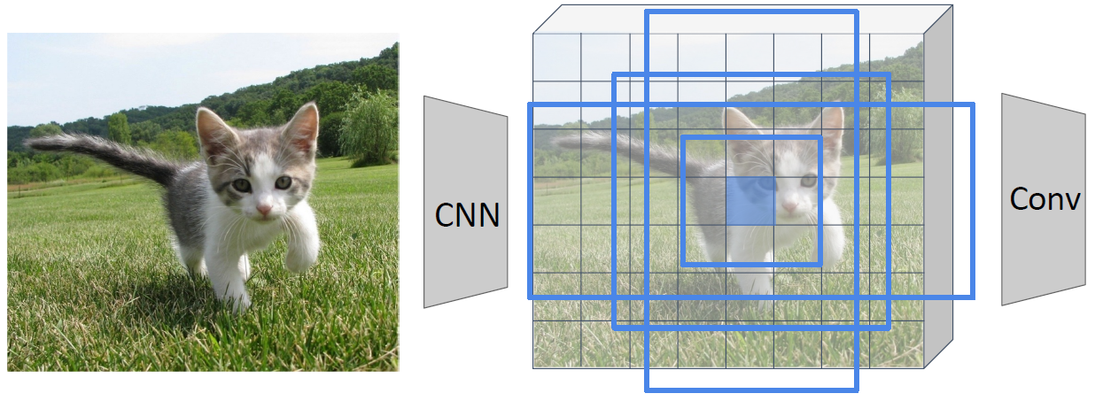
Region Proposal Network
Solution: Use K different anchor boxes at each point
Anchor is an object?
K x 20 x 15
Box Transforms
4K x 20 x 15
Computer Vision

Slide 39
Region Proposal Network
At test time: sort all K*20*15 boxes by their score, and take the top ~300 as region proposals
Anchor is an object?
K x 20 x 15
Box Transforms
4K x 20 x 15
Computer Vision

Slide 40
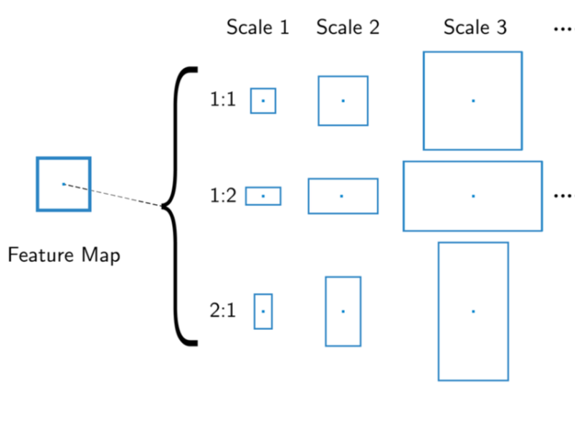
Anchor Boxes
Computer Vision

Slide 41
Faster R-CNN
Jointly train with 4 losses:
RPN classification: anchor box to classify [object/not]
RPN regression: predict transform from anchor box to proposal box
Object classification: score (object classes) of proposals
Object Regression: predict transform from proposal box to object box
[Ren et al, “Faster R-CNN: Towards Real-Time Object Detection with Region Proposal Networks”, NIPS 2015]
Computer Vision

Slide 42
Faster R-CNN
After RPN, use RoI Pooling and an upstream classifier
and bbox regressor just like Fast R-CNN
[Ren et al, “Faster R-CNN: Towards Real-Time Object Detection with Region Proposal Networks”, NIPS 2015]
Computer Vision

Slide 43
Faster R-CNN Results
 | R-CNN | Fast R-CNN | Faster R-CNN
Test time per image with proposal | 49 seconds | 2.3 seconds | 0.2 seconds
speedup | 1x | 25x | 250x
mAP (VOC 2007) | 66.0 | 66.9 | 66.9
Computer Vision

Slide 44
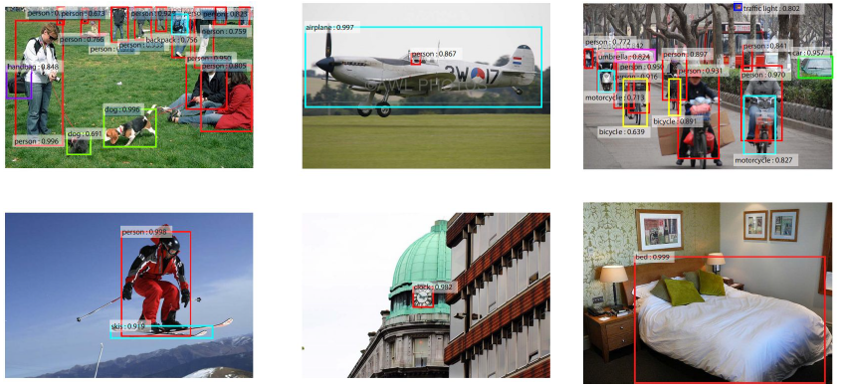
Results from Faster R-CNN
Computer Vision

Slide 45
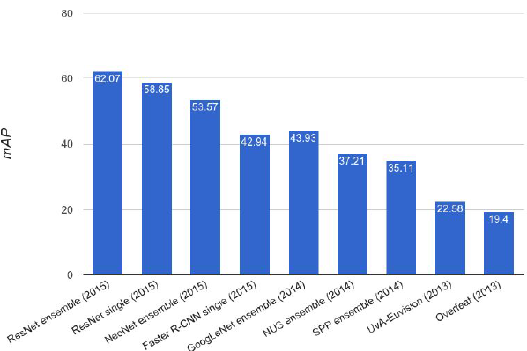
ImageNet Detection 2013-2015
Computer Vision

Slide 46

Break, Question?
Computer Vision

